Slide 1

Privacy Breach Detection and Security Analysis Using Differential Privacy By: Poshan pandey

Slide 2
AGENDA
Introduction
Dataset
Data Preparation
Creating the Network Graph
Centrality Measures
Community Detection
Anomaly Detection
Privacy Risk Scoring
Analysis and Insights
Challenges
Conclusion
Future Work

Slide 3
Introduction
aim to enhance the security and privacy of social network data by detecting potential privacy breaches and unauthorized access patterns
Securing social network data is crucial as it contains sensitive information that, if compromised, can lead to significant privacy violations.
The objectives of this project include network analysis, community detection, anomaly detection, and privacy risk scoring.

Slide 4

Dataset
Twitter Social Network Dataset from the Stanford Large Network Dataset Collection (SNAP)
This dataset contains information about Twitter users and their follower-followed relationships, allowing us to construct a social network graph.
The data is in a simple format with 'Source' and 'Target' columns representing the edges of the graph.“
Number of nodes: 81306
Number of edges: 1342310

Slide 5
Data Preparation
load and preprocess the dataset
Data is clean and preprocessed
Converted it into data frame

Slide 6

Creating Network graph
Using NetworkX to create the graph
The graph's basic properties, such as the number of nodes and edges, provide an initial understanding of the network's structure
Used network library for this
For instance, the number of nodes represents the users, and the edges represent the follower-followed relationships.

Slide 7
Centrality Measures
Centrality measures are crucial for understanding the importance and influence of nodes within the network.
Calculating degree, clustering coefficient, betweenness, closeness, and eigenvector centrality
These measures help identify key nodes and their roles in the network.

Slide 8
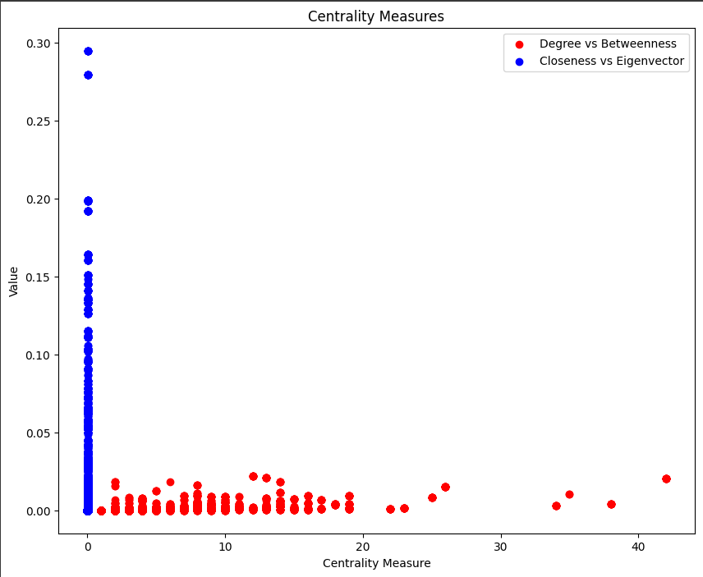
Centrality measures visualization

Slide 9
Community detection
Community detection helps identify clusters of nodes that are more connected to each other than to the rest of the network
greedy modularity communities algorithm to detect communities within the graph
The distribution of nodes across different communities provides insights into the network's structure and potential subgroups.

Slide 10
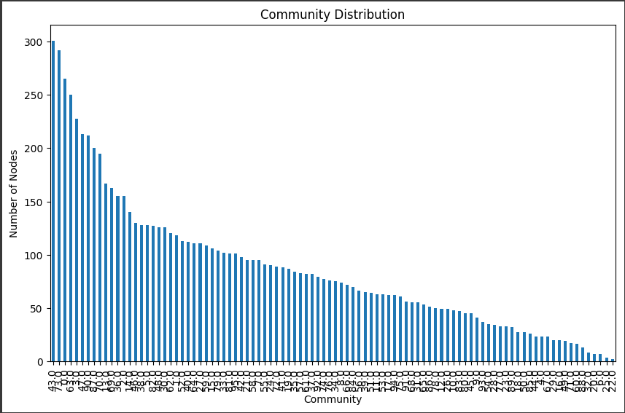
Community Detection visualization

Slide 11
Anomaly detection
To detect anomalies, we used machine learning algorithms such as Isolation Forest and One-Class SVM.
These algorithms identify outliers or unusual patterns in the data.
By combining the results from both methods, improved the robustness of this anomaly detection

Slide 12
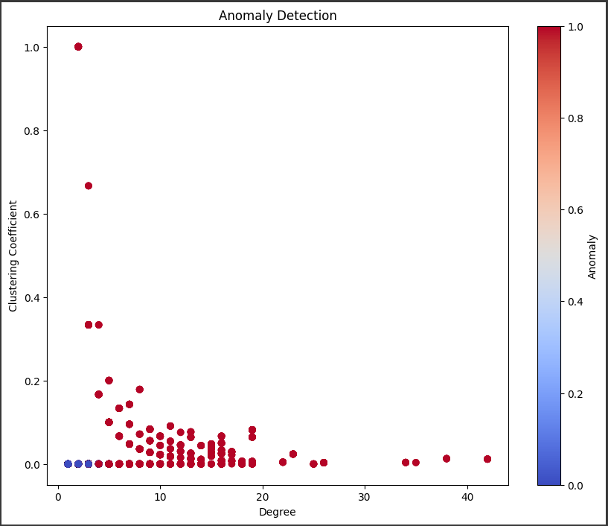
Anomaly Detection visualization

Slide 13
Anomaly detection with differential privacy
Add Noise to Centrality Measures
Use Differentially Private Data for Anomaly Detection
Train and Predict Using Differentially Private Data
Evaluate Models
Isolation Forest with DP - Accuracy: 0.94, Precision: 0.08
One-Class SVM with DP - Accuracy: 0.50, Precision: 0.05

Slide 14
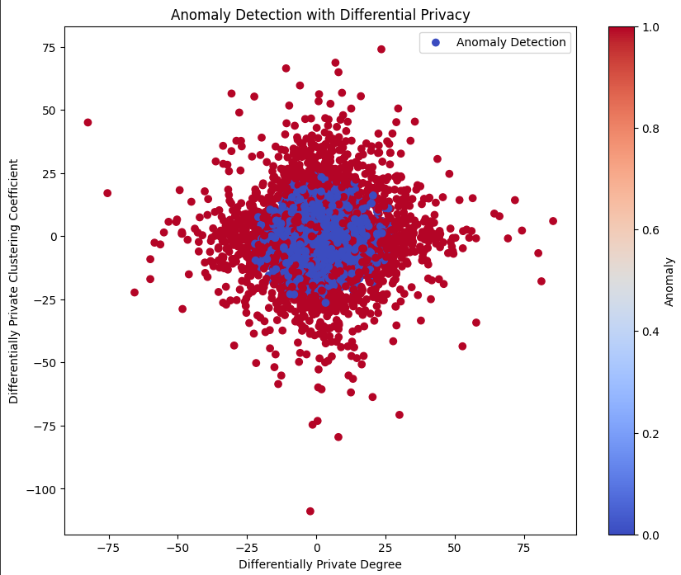
Anomaly Detection with differential privacy

Slide 15
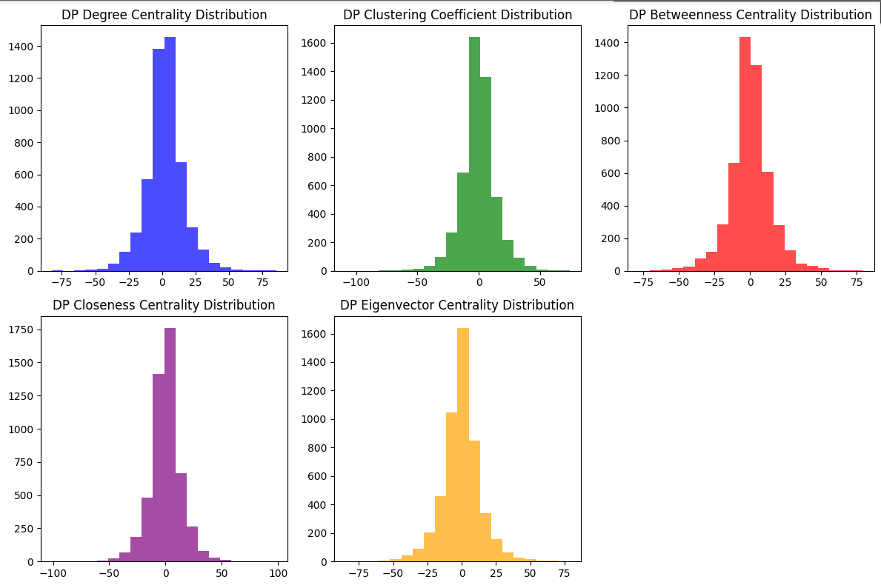
Anomaly Detection with differential privacy

Slide 16
Anomaly detection with differential privacy adding Laplace Noise
Add Laplace Noise to Centrality Measures
Prepare Data and Perform Anomaly Detection
Calculate Accuracy and Precision
Plot Results
Evaluate Models
Isolation Forest with DP - Accuracy: 0.94, Precision: 0.08
One-Class SVM with DP - Accuracy: 0.50, Precision: 0.05

Slide 17
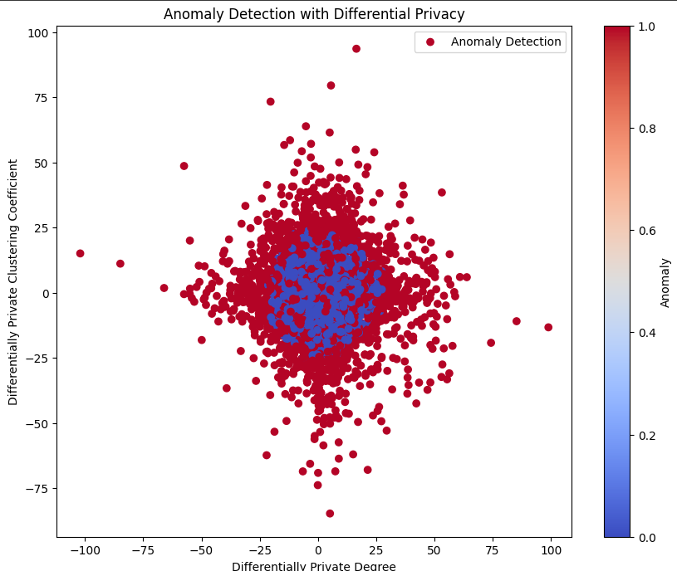
Anomaly Detection with dP with laplace noise

Slide 18
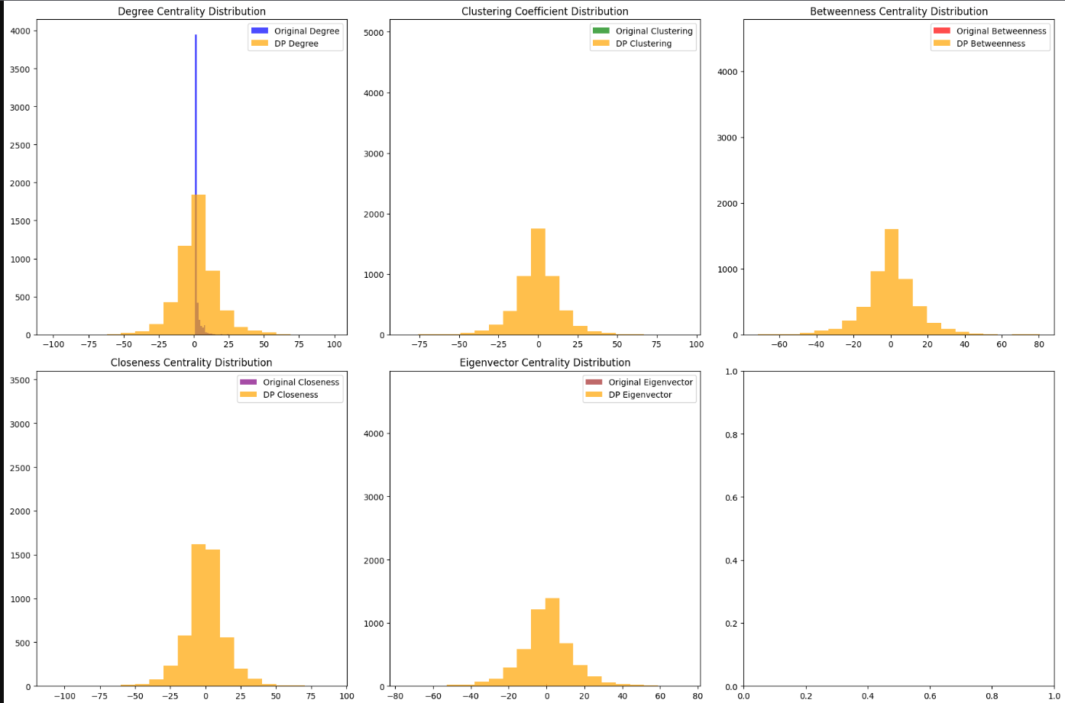
Anomaly Detection with dP with laplace noise

Slide 19
Privacy risk scoring
a privacy risk scoring system that aggregates various centrality measures to score nodes based on their risk of privacy breaches
This scoring system helps identify nodes that are more likely to be involved in privacy violations
The visualization of privacy risk scores provides a clear representation of nodes with higher risk.

Slide 20
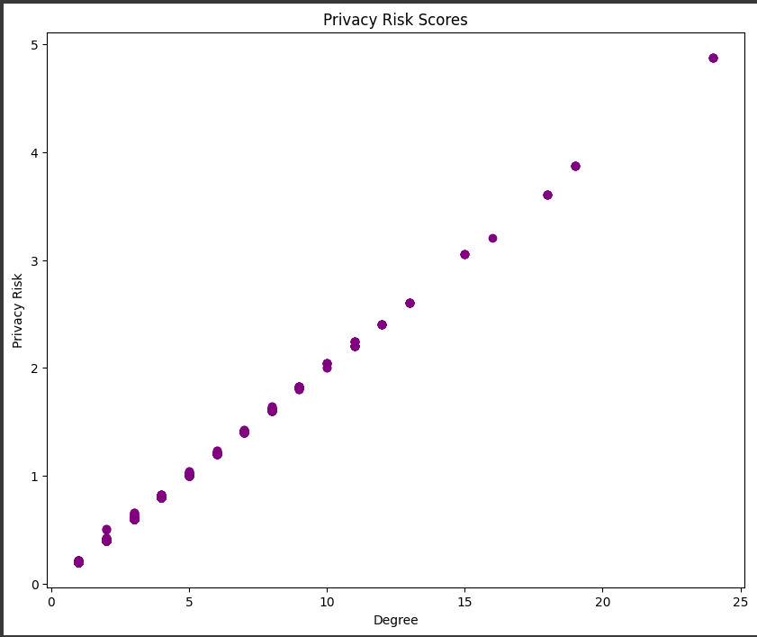
Privacy risk scoring visualization

Slide 21
Analysis & Insights
Analysis
Centrality identified influential nodes
Most nodes have less betweenness centrality
Eigen vector centrality is 0 for most nodes
Community highlighted subgroups within the network
Anomaly detection uncovered potential privacy breached
Isolation Forest - Accuracy: 0.94, Precision: 0.05
One-Class SVM - Accuracy: 0.67, Precision: 0.05
Privacy risk scoring system identified nodes with higher risks
it suggests a strong correlation between the centrality measures and the calculated privacy risk scores
Insights
These insights are crucial for enhancing the security and privacy of social network data.

Slide 22
Challenges
First and the most important challenge was the size of data.
Number of nodes: 81306
Number of edges: 1342310
Had to use sample size of 5000 for efficient running of the program
Lack of CPU/GPU processing power

Slide 23

Conclusion
In conclusion, this project successfully analyzed the security and privacy aspects of social network data, detecting potential privacy breaches and unauthorized access patterns.

Slide 24
Future work
Future work could involve enhancing the anomaly detection algorithms, incorporating additional features, and extending the analysis to other social networks. This project lays the foundation for further research and development in securing social network data.

Slide 25
THANK YOU
Poshan Pandey
ppandey6@hawk.iit.edu

